Slide 1
Servlet Basics
Mahadevan Subramanian
Vijay B K

Slide 2
Antrix Consultancy Services
Agenda
§ Servlet in big picture of J2EE
§ Servlet request & response model
§ Servlet life cycle
§ Servlet scope objects
§ Servlet request
§ Servlet response: Status, Header, Body
§ Error Handling
Madhusudhanan.P.K.

Slide 3
Antrix Consultancy Services
Servlet in a
Big Picture of J2EE
Madhusudhanan.P.K.

Slide 4
Antrix Consultancy Services
What is Servlet?
§ Java™ objects which are based on servlet framework and APIs and extend the functionality of a HTTP server.
§ Mapped to URLs and managed by container with a simple architecture
§ Available and running on all major
web servers and app servers
§ Platform and server independent
Madhusudhanan.P.K.

Slide 5
Antrix Consultancy Services
First Servlet Code
Public class HelloServlet extends HttpServlet {
public void doGet(HttpServletRequest request, HttpServletResponse response){
response.setContentType("text/html");
PrintWriter out = response.getWriter();
out.println("<title>Hello World!</title>"); }
}
Madhusudhanan.P.K.

Slide 6
Antrix Consultancy Services
Advantages of Servlet
§ No CGI limitations
§ Abundant third-party tools and Web servers supporting Servlet
§ Access to entire family of Java APIs
§ Reliable, better performance and scalability
§ Platform and server independent
§ Secure
§ Most servers allow automatic reloading of Servlet's by administrative action
Madhusudhanan.P.K.

Slide 7
Antrix Consultancy Services
What is JSP Technology?
§ Enables separation of business logic from presentation
Presentation is in the form of HTML or XML/XSLT
Business logic is implemented as Java Beans or custom tags Better maintainability, reusability
§ Extensible via custom tags
§ Builds on Servlet technology
Madhusudhanan.P.K.

Slide 8
Antrix Consultancy Services
What is JSP page?
§ A text-based document capable of returning dynamic content to a client browser
§ Contains both static and dynamic content
Static content: HTML, XML
Dynamic content: programming code, and JavaBeans, custom tags
Madhusudhanan.P.K.

Slide 9
Antrix Consultancy Services
JSP Sample Code
<html>
Hello World! <br>
<jsp:useBean id="clock"
class=“calendar.JspCalendar” />
Today is
<ul>
<li>Day of month: <%= clock.getDayOfMonth() %>
<li>Year: <%= clock.getYear() %> </ul>
</html>
Madhusudhanan.P.K.

Slide 10

Antrix Consultancy Services
Servlets
JSP
• HTML code in Java
• Java-like code in HTML
• Any form of Data
• Structured Text
• Not easy to author a web page
• Very easy to author a web page
• Code is compiled into a servlet
Madhusudhanan.P.K.

Slide 11
Antrix Consultancy Services
JSP Benefits
§ Content and display logic are separated
§ Simplify development with JSP, JavaBeans and custom tags
§ Supports software reuse through the use of components
§ Recompile automatically when changes are made to the source file
§ Easier to author web pages
§ Platform-independent
Madhusudhanan.P.K.

Slide 12
Antrix Consultancy Services
When to use Servlet over JSP
§ Extend the functionality of a Web server such as supporting a new file format
§ Generate objects that do not contain HTML such as graphs or pie charts
§ Avoid returning HTML directly from your servlets whenever possible
Madhusudhanan.P.K.

Slide 13
Antrix Consultancy Services
Servlet Request & Response Model
Madhusudhanan.P.K.

Slide 14
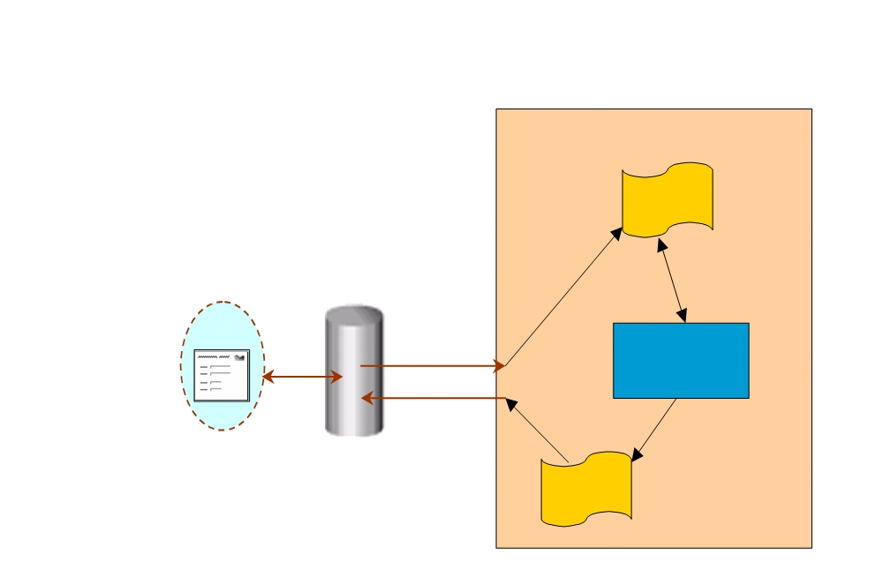
Antrix Consultancy Services
Servlet Request and Response Model
Servlet Container
Request
Browser
HTTP
Request
Servlet
Response
Web Server
Response
Madhusudhanan.P.K.

Slide 15
Antrix Consultancy Services
What does Servlet Do?
§ Receives client request (mostly in the form of HTTP request)
§ Extract some information from the request
§ Do content generation or business logic process (possibly by accessing database, invoking EJBs, etc)
§ Create and send response to client (mostly in the form of HTTP response) or forward the request to another servlet
Madhusudhanan.P.K.

Slide 16
Antrix Consultancy Services
Requests and Responses
§ What is a request?
Information that is sent from client to a server
• Who made the request
• What user-entered data is sent
• Which HTTP headers are sent
§ What is a response?
Information that is sent to client from a server
• Text(html, plain) or binary(image) data
• HTTP headers, cookies, etc
Madhusudhanan.P.K.

Slide 17
Antrix Consultancy Services
HTTP GET and POST
§ The most common client requests
HTTP GET & HTTP POST
§ GET requests:
User entered information is appended to the URL in a query string Can only send limited amount of data
• .../servlet/ViewCourse?FirstName=Sang&LastName=Shin
§ POST requests:
User entered information is sent as data (not appended to URL) Can send any amount of data
Madhusudhanan.P.K.

Slide 18
Antrix Consultancy Services
First Servlet
import javax.servlet.*;
import javax.servlet.http.*; import java.io.*;
Public class HelloServlet extends HttpServlet { public void doGet(HttpServletRequest request,
HttpServletResponse
response)
throws ServletException, IOException { response.setContentType("text/html"); PrintWriter out = response.getWriter(); out.println("<title>First Servlet</title>"); out.println("<big>Hello Code Camp!</big>"); }
}
Madhusudhanan.P.K.

Slide 19
Antrix Consultancy Services
Servlet Life-Cycle
Madhusudhanan.P.K.

Slide 20
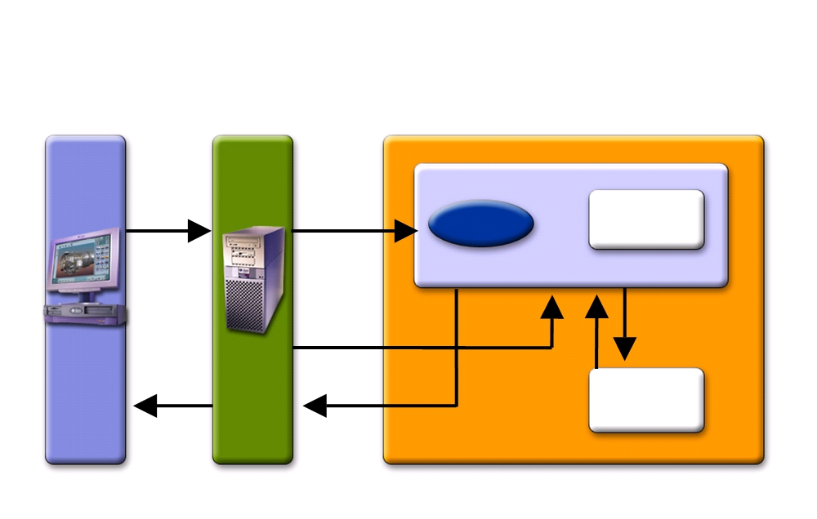
Antrix Consultancy Services
Servlet Life-Cycle
Is Servlet Loaded?
Http
request
Load Invoke
No
Http
response
Yes
Run
Servlet
Servlet Container
Client
Server
Madhusudhanan.P.K.

Slide 21
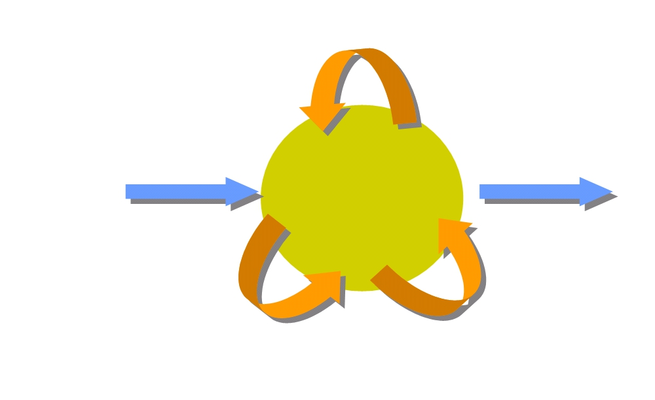
Antrix Consultancy Services
Servlet Life Cycle Methods
service( )
init( )
destroy( )
Ready
Init parameters
doGet( )
doPost( )
Request parameters
Madhusudhanan.P.K.

Slide 22
Antrix Consultancy Services
Servlet Life Cycle Methods
§ Invoked by container
Container controls life cycle of a servlet
§ Defined in
javax.servlet.GenericServlet class
• init()
• destroy()
• service() - this is an abstract method
javax.servlet.http.HttpServlet class
• doGet(), doPost(), doXxx()
• service() - implementation
Madhusudhanan.P.K.

Slide 23
Antrix Consultancy Services
Servlet Life Cycle Methods
§ init()
Invoked once when the servlet is first instantiated Perform any set-up in this method
• Setting up a database connection
§ destroy()
Invoked before servlet instance is removed Perform any clean-up
• Closing a previously created database connection
Madhusudhanan.P.K.

Slide 24
Antrix Consultancy Services
Example: init() from CatalogServlet.java
public class CatalogServlet extends HttpServlet {
private BookDB bookDB;
// Perform any one-time operation for the servlet, // like getting database connection object.
// Note: In this example, database connection object is assumed
// to be created via other means (via life cycle event mechanism) // and saved in ServletContext object. This is to share a same // database connection object among multiple servlets.
public void init() throws ServletException { bookDB = (BookDB)getServletContext().
getAttribute("bookDB");
if (bookDB == null) throw new
UnavailableException("Couldn't get database.");
}
}
Madhusudhanan.P.K.

Slide 25
Antrix Consultancy Services
Example: init() reading Configuration parameters
public void init(ServletConfig config) throws ServletException {
super.init(config);
String driver = getInitParameter("driver"); String fURL = getInitParameter("url");
try {
openDBConnection(driver, fURL); } catch (SQLException e) { e.printStackTrace();
} catch (ClassNotFoundException e){ e.printStackTrace();
}
}
Madhusudhanan.P.K.

Slide 26
Antrix Consultancy Services
Setting Init Parameters in web.xml
<web-app>
<servlet>
<servlet-name>chart</servlet-name>
<servlet-class>ChartServlet</servlet-class> <init-param>
<param-name>driver</param-name> <param-value>
COM.cloudscape.core.RmiJdbcDriver
</param-value>
</init-param>
<init-param>
<param-name>url</param-name> <param-value>
jdbc:cloudscape:rmi:CloudscapeDB
</param-value>
</init-param> </servlet> </web-app>
Madhusudhanan.P.K.

Slide 27
Antrix Consultancy Services
Example: destroy()
public class CatalogServlet extends HttpServlet { private BookDB bookDB;
public void init() throws ServletException { bookDB = (BookDB)getServletContext().
getAttribute("bookDB");
if (bookDB == null) throw new
UnavailableException("Couldn't get database.");
}
public void destroy() { bookDB = null;
}
}
Madhusudhanan.P.K.

Slide 28
Antrix Consultancy Services
Servlet Life Cycle Methods
§ service() javax.servlet.GenericServlet class Abstract method
§ service() in javax.servlet.http.HttpServlet class Concrete method (implementation)
Dispatches to doGet(), doPost(), etc
Do not override this method!
§ doGet(), doPost(), doXxx() in in javax.servlet.http.HttpServlet Handles HTTP GET, POST, etc. requests
Override these methods in your servlet to provide desired behavior
Madhusudhanan.P.K.

Slide 29
Antrix Consultancy Services
service() & doGet()/doPost()
§ service() methods take generic requests and responses:
service(ServletRequest request,
ServletResponse response)
§ doGet() or doPost() take HTTP requests and responses:
doGet(HttpServletRequest request,
HttpServletResponse response) doPost(HttpServletRequest request, HttpServletResponse response)
Madhusudhanan.P.K.

Slide 30
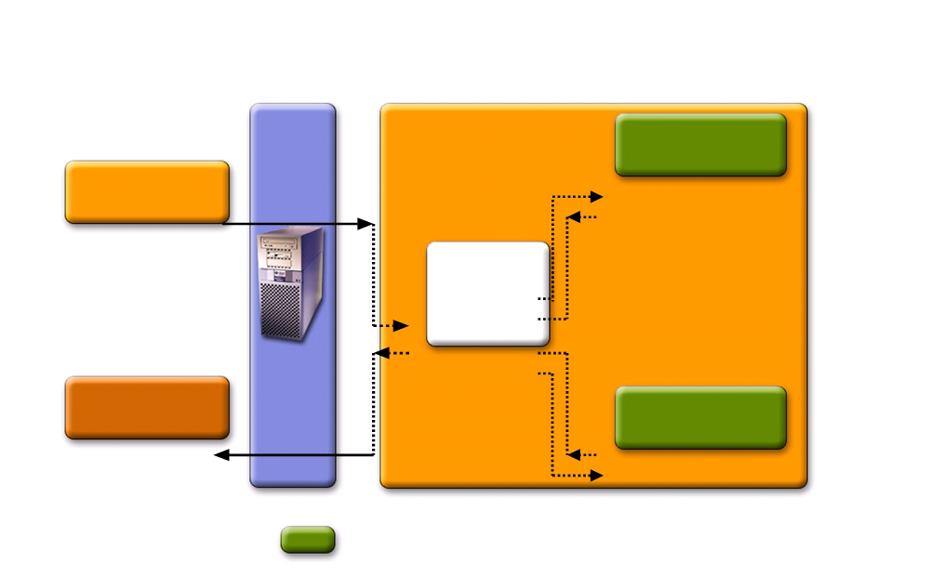
Antrix Consultancy Services
doGet() and doPost() Methods
Server
HttpServlet subclass
doGet( )
Request
Service( )
Response
doPost( )
Key:
Implemented by subclass
Madhusudhanan.P.K.

Slide 31
Antrix Consultancy Services
Things You Do in doGet() & doPost()
§ Extract client-sent information (HTTP parameter) from HTTP request
§ Set (Save) and get (read) attributes to/from Scope objects
§ Perform some business logic or access database
§ Optionally forward the request to other Web components (Servlet or JSP)
§ Populate HTTP response message and send it to client
Madhusudhanan.P.K.

Slide 32
Antrix Consultancy Services
Example: Simple doGet()
import javax.servlet.*;
import javax.servlet.http.*; import java.io.*;
Public class HelloServlet extends HttpServlet { public void doGet (HttpServletRequest request,
HttpServletResponse
response)
throws ServletException, IOException {
// Just send back a simple HTTP response
response.setContentType("text/html");
PrintWriter out = response.getWriter();
out.println("<title>First Servlet</title>");
out.println("<big>Hello J2EE Programmers! </big>"); }
}

Slide 33
Antrix Consultancy Services
Example: Sophisticated doGet()
public void doGet (HttpServletRequest request,
HttpServletResponse response)
throws ServletException, IOException {
// Read session-scope attribute “message”
HttpSession session = request.getSession(true);
ResourceBundle messages = (ResourceBundle)session.getAttribute("messages");
// Set headers and buffer size before accessing the Writer
response.setContentType("text/html");
response.setBufferSize(8192);
PrintWriter out = response.getWriter();
// Then write the response (Populate the header part of the response)
out.println("<html>" +
"<head><title>" + messages.getString("TitleBookDescription") + "</title></head>");
// Get the dispatcher; it gets the banner to the user
RequestDispatcher dispatcher =
getServletContext().getRequestDispatcher("/banner");
if (dispatcher != null)
dispatcher.include(request, response);
Madhusudhanan.P.K.

Slide 34
Antrix Consultancy Services
Example: Sophisticated doGet()
// Get the identifier of the book to display (Get HTTP parameter)
String bookId = request.getParameter("bookId");
if (bookId != null) {
// and the information about the book (Perform business logic)
try {
BookDetails bd = bookDB.getBookDetails(bookId);
Currency c = (Currency)session.getAttribute("currency"); if (c == null) {
c = new Currency();
c.setLocale(request.getLocale());
session.setAttribute("currency", c); }
c.setAmount(bd.getPrice());
// Print out the information obtained
out.println("...");
} catch (BookNotFoundException ex) { response.resetBuffer();
throw new ServletException(ex);
}
}
out.println("</body></html>"); out.close();
}
Madhusudhanan.P.K.

Slide 35
Antrix Consultancy Services
Steps of Populating HTTP Response
§ Fill Response headers
§ Set some properties of the response
Buffer size
§ Retrieve an output stream from the response
§ Write body content to the output stream
Madhusudhanan.P.K.

Slide 36
Antrix Consultancy Services
Example: Simple Response
Public class HelloServlet extends HttpServlet {
public void doGet(HttpServletRequest request,
HttpServletResponse
response)
throws ServletException, IOException {
// Fill response headers
response.setContentType("text/html");
// Set buffer size
response.setBufferSize(8192);
// Retrieve an output stream from the response
PrintWriter out = response.getWriter();
// Write body content to output stream
out.println("<title>First Servlet</title>");
out.println("<big>Hello J2EE Programmers! </big>"); }
}
Madhusudhanan.P.K.

Slide 37
Antrix Consultancy Services
Scope Objects
Madhusudhanan.P.K.

Slide 38
Antrix Consultancy Services
Scope Objects
§ Enables sharing information among collaborating web components via attributes maintained in Scope objects
§ Attributes of Scope objects are accessed with
getAttribute()
setAttribute()
§ 4 Scope objects are defined
Web context, session, request, page
Madhusudhanan.P.K.

Slide 39
Antrix Consultancy Services
Four Scope Objects: Accessibility
§ Web context (ServletConext)
Accessible from Web components within a Web context
§ Session
Accessible from Web components handling a request that belongs to the session
§ Request
Accessible from Web components handling the request
§ Page
Accessible from JSP page that creates the object
Madhusudhanan.P.K.

Slide 40
Antrix Consultancy Services
Four Scope Objects: Class
§ Web context
javax.servlet.ServletContext
§ Session
javax.servlet.http.HttpSession
§ Request
subtype of javax.servlet.ServletRequest: javax.servlet.HttpServletRequest
§ Page
javax.servlet.jsp.PageContext
Madhusudhanan.P.K.

Slide 41
Antrix Consultancy Services
Web Context
(ServletContext)
Madhusudhanan.P.K.

Slide 42
Antrix Consultancy Services
What is ServletContext For?
§ Used by servlets to
Set and get context-wide object-valued attributes Get request dispatcher
• To forward to or include web component
Access Web context-wide initialization parameters set in the web.xml file Access Web resources associated with the Web context Log
Access other misc. information
Madhusudhanan.P.K.

Slide 43
Antrix Consultancy Services
Scope of ServletContext
§ Context-wide scope
Shared by all servlets and JSP pages within a "web application"
• Why it is called “web application scope”
A "web application" is a collection of servlets and content installed under a specific subset of the server's URL namespace and possibly installed via a *.war file
• All servlets in BookStore web application share same ServletContext object
There is one ServletContext object per "web application" per Java Virtual Machine
Madhusudhanan.P.K.

Slide 44
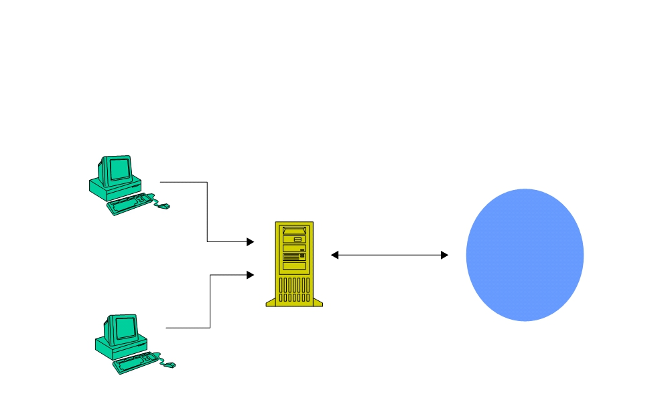
Antrix Consultancy Services
ServletContext:
Web Application Scope
Client 1
ServletContext
server
application
Client 2
Madhusudhanan.P.K.

Slide 45
Antrix Consultancy Services
How to Access ServletContext Object?
§ Within your servlet code, call getServletContext()
§ Within your servlet filter code, call getServletContext()
§ The ServletContext is contained in ServletConfig object, which the Web server provides to a servlet when the servlet is initialized
init (ServletConfig servletConfig) in Servlet interface
Madhusudhanan.P.K.

Slide 46
Antrix Consultancy Services
Example: Getting Attribute Value from ServletContext
public class CatalogServlet extends HttpServlet { private BookDB bookDB;
public void init() throws ServletException {
// Get context-wide attribute value from // ServletContext object
bookDB = (BookDB)getServletContext().
getAttribute("bookDB");
if (bookDB == null) throw new
UnavailableException("Couldn't get database.");
}
}
Madhusudhanan.P.K.

Slide 47
Antrix Consultancy Services
Example: Getting and Using RequestDispatcher Object
public void doGet (HttpServletRequest request,
HttpServletResponse response)
throws ServletException, IOException {
HttpSession session = request.getSession(true); ResourceBundle messages =
(ResourceBundle)session.getAttribute("messages");
// set headers and buffer size before accessing the Writer response.setContentType("text/html");
response.setBufferSize(8192);
PrintWriter out = response.getWriter();
// then write the response
out.println("<html>" +
"<head><title>" + messages.getString("TitleBookDescription")
+
"</title></head>");
// Get the dispatcher; it gets the banner to the user RequestDispatcher dispatcher =
getServletContext().getRequestDispatcher("/banner");
if (dispatcher != null)
dispatcher.include(request, response);
Madhusudhanan.P.K.

Slide 48
Antrix Consultancy Services
Example: Logging
public void doGet (HttpServletRequest request,
HttpServletResponse response)
throws ServletException, IOException {
getServletContext().log(“Life is good!”);
getServletContext().log(“Life is bad!”, someException);
Madhusudhanan.P.K.

Slide 49
Antrix Consultancy Services
Session
(HttpSession)
Madhusudhanan.P.K.

Slide 50
Antrix Consultancy Services
Why HttpSession?
§ Need a mechanism to maintain client state across a series of requests from a same user (or originating from the same browser) over some period of time
Example: Online shopping cart
§ Yet, HTTP is stateless
§ HttpSession maintains client state
Used by Servlets to set and get the values of session scope attributes
Madhusudhanan.P.K.

Slide 51
Antrix Consultancy Services
How to Get HttpSession?
§ via getSession() method of a Request object (HttpRequest)
Madhusudhanan.P.K.

Slide 52
Antrix Consultancy Services
Example: HttpSession
public class CashierServlet extends HttpServlet { public void doGet (HttpServletRequest request,
HttpServletResponse response)
throws ServletException, IOException {
// Get the user's session and shopping cart HttpSession session = request.getSession(); ShoppingCart cart =
(ShoppingCart)session.getAttribute("cart");
// Determine the total price of the user's books double total = cart.getTotal();
Madhusudhanan.P.K.

Slide 53
Antrix Consultancy Services
Servlet Request
(HttpServletRequest)
Madhusudhanan.P.K.

Slide 54
Antrix Consultancy Services
What is Servlet Request?
§ Contains data passed from client to servlet
§ All servlet requests implement ServletRequest interface which defines methods for accessing
Client sent parameters
Object-valued attributes Locales
Client and server Input stream
Protocol information Content type
If request is made over secure channel (HTTPS)
Madhusudhanan.P.K.

Slide 55
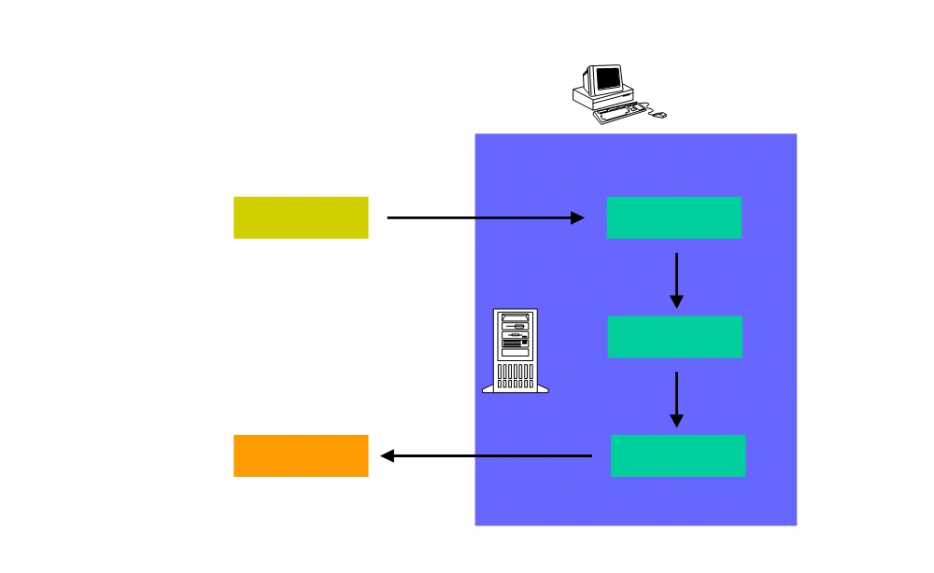
Antrix Consultancy Services
Requests
data,
client, server, header servlet itself
Request
Servlet 1
Servlet 2
Response
Servlet 3
Web Server
Madhusudhanan.P.K.

Slide 56
Antrix Consultancy Services
Getting Client Sent Parameters
§ A request can come with any number of parameters
§ Parameters are sent from HTML forms:
GET: as a query string, appended to a URL
POST: as encoded POST data, not appeared in the URL
§ getParameter("paraName")
Returns the value of paraName
Returns null if no such parameter is present Works identically for GET and POST requests
Madhusudhanan.P.K.

Slide 57
Antrix Consultancy Services
A Sample FORM using GET
<!DOCTYPE HTML PUBLIC "-//W3C//DTD HTML 4.0 Transitional//EN"> <HTML>
<HEAD>
<TITLE>Collecting Three Parameters</TITLE> </HEAD>
<BODY BGCOLOR="#FDF5E6">
<H1 ALIGN="CENTER">Please Enter Your Information</H1>
<FORM ACTION="/sample/servlet/ThreeParams">
First Name:
<INPUT TYPE="TEXT" NAME="param1"><BR>
Last Name:
<INPUT TYPE="TEXT" NAME="param2"><BR>
Class Name:
<INPUT TYPE="TEXT" NAME="param3"><BR>
<CENTER>
<INPUT TYPE="SUBMIT">
</CENTER>
</FORM>
</BODY> </HTML>
Madhusudhanan.P.K.

Slide 58
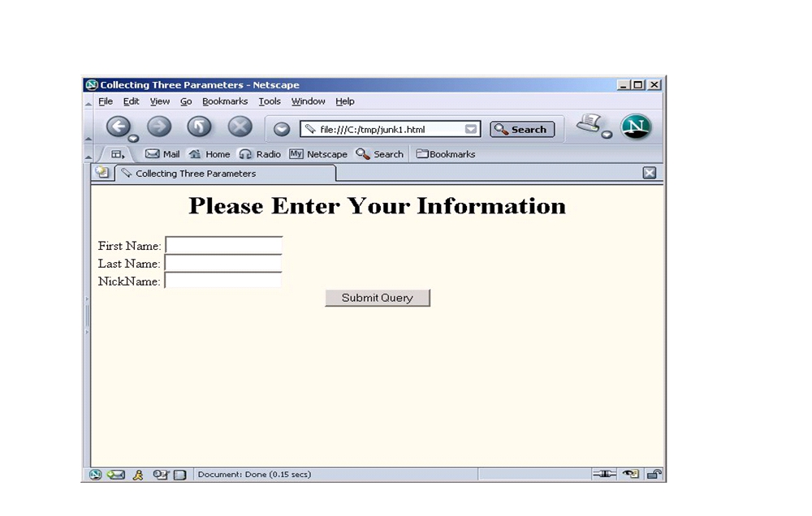
Antrix Consultancy Services
A Sample FORM using GET
Madhusudhanan.P.K.

Slide 59
Antrix Consultancy Services
import java.io.*;
import javax.servlet.*;
import javax.servlet.http.*;
/** Simple servlet that reads three parameters from the html form */ public class ThreeParams extends HttpServlet {
public void doGet(HttpServletRequest request,
HttpServletResponse response)
throws ServletException, IOException {
response.setContentType("text/html");
PrintWriter out = response.getWriter(); String title = "Your Information"; out.println("<HTML>" +
"<BODY BGCOLOR=\"#FDF5E6\">\n" +
"<H1 ALIGN=CENTER>" + title + "</H1>\n" + "<UL>\n" +
" <LI><B>First Name in Response</B>: " + request.getParameter("param1") + "\n" + "<LI><B>Last Name in Response</B>: " + request.getParameter("param2") + "\n" + "<LI><B>NickName in Response</B>: " + request.getParameter("param3") + "\n" + "</UL>\n" +
"</BODY></HTML>");
}
}
Madhusudhanan.P.K.

Slide 60
Antrix Consultancy Services
A Sample FORM using POST
<!DOCTYPE HTML PUBLIC "-//W3C//DTD HTML 4.0 Transitional//EN"> <HTML>
<HEAD>
<TITLE>A Sample FORM using POST</TITLE> </HEAD>
<BODY BGCOLOR="#FDF5E6">
<H1 ALIGN="CENTER">A Sample FORM using POST</H1>
<FORM ACTION="/sample/servlet/ShowParameters" METHOD="POST">
Item Number: <INPUT TYPE="TEXT" NAME="itemNum"><BR>
Quantity: <INPUT TYPE="TEXT" NAME="quantity"><BR>
Price Each: <INPUT TYPE="TEXT" NAME="price" VALUE="$"><BR> First Name: <INPUT TYPE="TEXT" NAME="firstName"><BR> <TEXTAREA NAME="address" ROWS=3 COLS=40></TEXTAREA><BR> Credit Card Number:
<INPUT TYPE="PASSWORD" NAME="cardNum"><BR> <CENTER>
<INPUT TYPE="SUBMIT" VALUE="Submit Order">
</CENTER>
</FORM>
</BODY> </HTML>
Madhusudhanan.P.K.

Slide 61

Antrix Consultancy Services
A Sample FORM using POST
Madhusudhanan.P.K.

Slide 62
Antrix Consultancy Services
A Form Based Servlet: POST
import java.io.*;
import javax.servlet.*;
import javax.servlet.http.*;
public class ShowParameters extends HttpServlet { public void doGet(HttpServletRequest request,
HttpServletResponse response)
throws ServletException, IOException {
}
public void doPost(HttpServletRequest request,
HttpServletResponse response) throws ServletException, IOException { doGet(request, response);
}
}
Madhusudhanan.P.K.

Slide 63
Antrix Consultancy Services
Who Set Object/value Attributes
§ Request attributes can be set in two ways
Servlet container itself might set attributes to make available custom information about a request
• example: javax.servlet.request.X509Certificate attribute for HTTPS Servlet set application-specific attribute
• void setAttribute(java.lang.String name, java.lang.Object o)
• Embedded into a request before a RequestDispatcher call
Madhusudhanan.P.K.

Slide 64
Antrix Consultancy Services
Getting Locale Information
public void doGet (HttpServletRequest request,
HttpServletResponse response)
throws ServletException, IOException {
HttpSession session = request.getSession(); ResourceBundle messages =
(ResourceBundle)session.getAttribute("messages");
if (messages == null) {
Locale locale=request.getLocale();
messages = ResourceBundle.getBundle(
"messages.BookstoreMessages", locale);
session.setAttribute("messages", messages);
}
Madhusudhanan.P.K.

Slide 65
Antrix Consultancy Services
Getting Client Information
§ Servlet can get client information from the request
String request.getRemoteAddr()
• Get client's IP address
String request.getRemoteHost()
• Get client's host name
Madhusudhanan.P.K.

Slide 66
Antrix Consultancy Services
Getting Server Information
§ Servlet can get server's information:
String request.getServerName()
• e.g. "www.sun.com"
int request.getServerPort()
• e.g. Port number "8080"
Madhusudhanan.P.K.

Slide 67
Antrix Consultancy Services
Getting Misc. Information
§ Input stream
ServletInputStream getInputStream() java.io.BufferedReader getReader()
§ Protocol
java.lang.String getProtocol()
§ Content type
java.lang.String getContentType()
§ Is secure or not (if it is HTTPS or not) boolean isSecure()
Madhusudhanan.P.K.

Slide 68
Antrix Consultancy Services
HTTPServletRequest
Madhusudhanan.P.K.

Slide 69
Antrix Consultancy Services
What is HTTP Servlet Request?
§ Contains data passed from HTTP client to HTTP servlet
§ Created by servlet container and passed to servlet as a parameter of doGet() or doPost() methods
§ HttpServletRequest is an extension of ServletRequest and provides additional methods for accessing
HTTP request URL
• Context, servlet, path, query information
Misc. HTTP Request header information
Authentication type & User security information Cookies
Session
Madhusudhanan.P.K.

Slide 70
Antrix Consultancy Services
HTTP Request URL
§ Contains the following parts
http://[host]:[port]/[request path]?[query string]
Madhusudhanan.P.K.

Slide 71
Antrix Consultancy Services
HTTP Request URL: [request path]
§ http://[host]:[port]/[request path]?[query string]
§ [request path] is made of
Context: /<context of web app>
Servlet name: /<component alias> Path information: the rest of it
§ Examples
http://localhost:8080/hello1/greeting
http://localhost:8080/hello1/greeting.jsp
http://daydreamer/catalog/lawn/index.html
Madhusudhanan.P.K.

Slide 72
Antrix Consultancy Services
HTTP Request URL: [query string]
§ http://[host]:[port]/[request path]?[query string]
§
[query string] are composed of a set of parameters and values that are user entered
§ Two ways query strings are generated
A query string can explicitly appear in a web page
• <a href="/bookstore1/catalog?Add=101">Add To Cart</a>
• String bookId = request.getParameter("Add");
A query string is appended to a URL when a form with a GET HTTP method is submitted
• http://localhost/hello1/greeting?username=Monica+Clinton
• String userName=request.getParameter(“username”)
Madhusudhanan.P.K.

Slide 73
Antrix Consultancy Services
Context, Path, Query, Parameter Methods
§ String getContextPath()
§ String getQueryString()
§ String getPathInfo()
§ String getPathTranslated()
Madhusudhanan.P.K.

Slide 74
Antrix Consultancy Services
HTTP Request Headers
§ HTTP requests include headers which provide extra information about the request
§ Example of HTTP 1.1 Request:
GET /search? keywords= servlets+ jsp HTTP/ 1.1
Accept: image/ gif, image/ jpg, */*
Accept-Encoding: gzip
Connection: Keep- Alive Cookie: userID= id456578 Host: www.sun.com
Referer: http:/www.sun.com/codecamp.html User-Agent: Mozilla/ 4.7 [en] (Win98; U)
Madhusudhanan.P.K.

Slide 75
Antrix Consultancy Services
HTTP Request Headers
§ Accept
Indicates MIME types browser can handle.
§ Accept-Encoding
Indicates encoding (e. g., gzip or compress) browser can handle
§ Authorization
User identification for password- protected pages
Instead of HTTP authorization, use HTML forms to send username/password and store info in session object
Madhusudhanan.P.K.

Slide 76
Antrix Consultancy Services
HTTP Request Headers
§ Connection
In HTTP 1.1, persistent connection is default
Servlets should set Content-Length with setContentLength (use
ByteArrayOutputStream to determine length of output) to support persistent connections.
§ Cookie
Gives cookies sent to client by server sometime earlier. Use getCookies, not getHeader
§ Host
Indicates host given in original URL. This is required in HTTP 1.1.
Madhusudhanan.P.K.

Slide 77
Antrix Consultancy Services
HTTP Request Headers
§ If-Modified-Since
Indicates client wants page only if it has been changed after specified date.
Don’t handle this situation directly; implement getLastModified instead.
§ Referer
URL of referring Web page.
Useful for tracking traffic; logged by many servers.
§ User-Agent
String identifying the browser making the request. Use with extreme caution!
Madhusudhanan.P.K.

Slide 78
Antrix Consultancy Services
HTTP Header Methods
§ String getHeader(java.lang.String name)
value of the specified request header as String
§ java.util.Enumeration getHeaders(java.lang.String name) values of the specified request header
§ java.util.Enumeration getHeaderNames()
names of request headers
§ int getIntHeader(java.lang.String name)
value of the specified request header as an int
Madhusudhanan.P.K.

Slide 79
Antrix Consultancy Services
Showing Request Headers
//Shows all the request headers sent on this particular request.
public class ShowRequestHeaders extends HttpServlet { public void doGet(HttpServletRequest request,
HttpServletResponse response)
throws ServletException, IOException {
response.setContentType("text/html");
PrintWriter out = response.getWriter();
String title = "Servlet Example: Showing Request Headers"; out.println("<HTML>" + ...
"<B>Request Method: </B>" +
request.getMethod() + "<BR>\n" + "<B>Request URI: </B>" +
request.getRequestURI() + "<BR>\n" + "<B>Request Protocol: </B>" + request.getProtocol() + "<BR><BR>\n" +
"<TH>Header Name<TH>Header Value");
Enumeration headerNames = request.getHeaderNames(); while(headerNames.hasMoreElements()) {
String headerName = (String)headerNames.nextElement(); out.println("<TR><TD>" + headerName);
out.println("
<TD>" + request.getHeader(headerName));
}
}
}
Madhusudhanan.P.K.

Slide 80
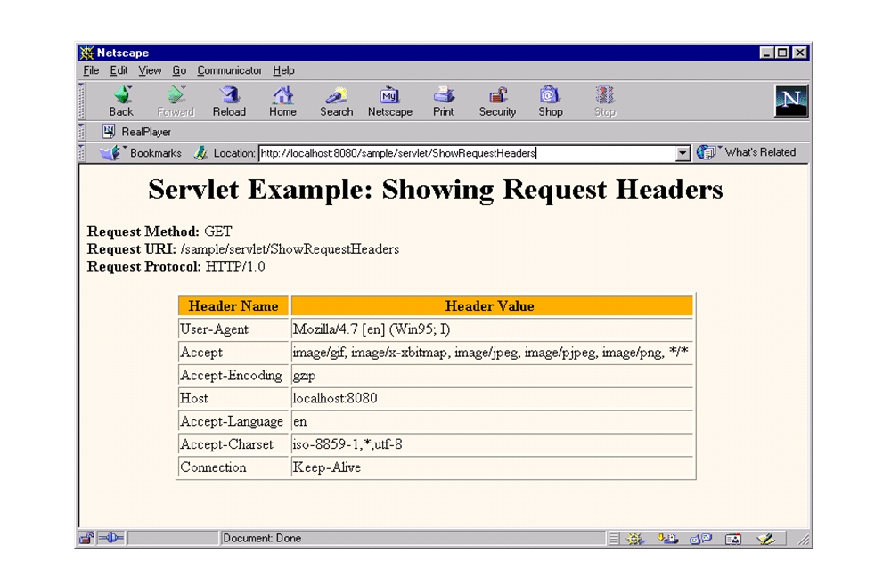
Antrix Consultancy Services
Request Headers Sample
Madhusudhanan.P.K.

Slide 81
Antrix Consultancy Services
Authentication & User Security Information Methods
§ String request.getRemoteUser()
name for the client user if the servlet has been password protected, null otherwise
§ String getAuthType()
name of the authentication scheme used to protect the servlet
§ boolean isUserInRole(java.lang.String role)
Is user is included in the specified logical "role"?
§ String getRemoteUser()
login of the user making this request, if the user has been authenticated, null otherwise
Madhusudhanan.P.K.

Slide 82
Antrix Consultancy Services
Cookie Method (in HTTPServletRequest)
§ Cookie[] getCookies()
an array containing all of the Cookie objects the client sent with this request
Madhusudhanan.P.K.

Slide 83
Antrix Consultancy Services
Servlet Response
(HttpServletResponse)
Madhusudhanan.P.K.

Slide 84
Antrix Consultancy Services
What is Servlet Response?
§ Contains data passed from servlet to client
§ All servlet responses implement ServletResponse interface Retrieve an output stream
Indicate content type
Indicate whether to buffer output Set localization information
§ HttpServletResponse extends ServletResponse
HTTP response status code
Cookies
Madhusudhanan.P.K.

Slide 85
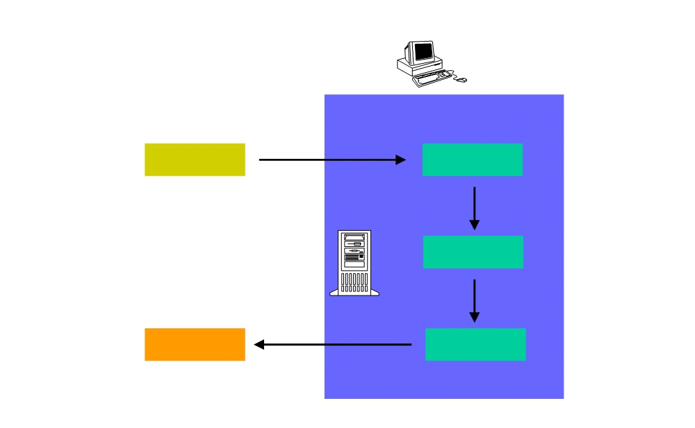
Antrix Consultancy Services
Responses
Request
Servlet 1
Response Structure:
Servlet 2
status code ,
headers and body.
Response
Servlet 3
Web Server
Madhusudhanan.P.K.

Slide 86

Antrix Consultancy Services
Response Structure
Status Code
Response Headers
Response Body
Madhusudhanan.P.K.

Slide 87
Antrix Consultancy Services
Status Code in Http Response
Madhusudhanan.P.K.

Slide 88
Antrix Consultancy Services
HTTP Response Status Codes
§ Why do we need HTTP response status code? Forward client to another page
Indicates resource is missing
Instruct browser to use cached copy
Madhusudhanan.P.K.

Slide 89
Antrix Consultancy Services
Methods for Setting HTTP Response Status Codes
§ public void setStatus(int statusCode)
Status codes are defined in HttpServletResponse
Status codes are numeric fall into five general categories:
•
100-199 Informational
•
200-299 Successful
•
300-399 Redirection
•
400-499 Incomplete
•
500-599 Server Error
Default status code is 200 (OK)
Madhusudhanan.P.K.

Slide 90
Antrix Consultancy Services
Example of HTTP Response Status
HTTP/ 1.1 200 OK
Content-Type: text/ html <! DOCTYPE ...>
<HTML
</ HTML>
Madhusudhanan.P.K.

Slide 91
Antrix Consultancy Services
§
200 (SC_OK)
Success and document follows
Default for servlets
§
204 (SC_No_CONTENT)
Success but no response body
Browser should keep displaying previous document
§
301 (SC_MOVED_PERMANENTLY)
The document moved permanently (indicated in Location header) Browsers go to new location automatically
Madhusudhanan.P.K.

Slide 92
Antrix Consultancy Services
§
ORARILY)
Note the message is "Found"
Requested document temporarily moved elsewhere (indicated in Location header)
Browsers go to new location automatically
Servlets should use sendRedirect, not setStatus, when setting this header
§
401 (SC_UNAUTHORIZED)
Browser tried to access password- protected page without proper
Authorization header
§
404 (SC_NOT_FOUND)
No such page
Madhusudhanan.P.K.

Slide 93
Antrix Consultancy Services
Methods for Sending Error
§ Error status codes (400-599) can be used in sendError methods.
§ public void sendError(int sc)
The server may give the error special treatment
§ public void sendError(int code, String message)
Wraps message inside small HTML document
Madhusudhanan.P.K.

Slide 94
Antrix Consultancy Services
setStatus() & sendError()
try {
returnAFile(fileName, out)
}
catch (FileNotFoundException e) {
response.setStatus(response.SC_NOT_FOUND); out.println("Response body");
}
has same effect as
try {
returnAFile(fileName, out)
}
catch (FileNotFoundException e) {
response.sendError(response.SC_NOT_FOUND);
}
Madhusudhanan.P.K.

Slide 95
Antrix Consultancy Services
Header in
Http Response
Madhusudhanan.P.K.

Slide 96
Antrix Consultancy Services
Why HTTP Response Headers?
§ Give forwarding location
§ Specify cookies
§ Supply the page modification date
§ Instruct the browser to reload the page after a designated interval
§ Give the file size so that persistent HTTP connections can be used
§ Designate the type of document being generated
Madhusudhanan.P.K.

Slide 97
Antrix Consultancy Services
Methods for Setting Arbitrary Response Headers
§ public void setHeader( String headerName, String headerValue) Sets an arbitrary header.
§ public void setDateHeader( String name, long millisecs)
Converts milliseconds since 1970 to a date string in GMT format
§ public void setIntHeader( String name, int headerValue)
Prevents need to convert int to String before calling setHeader
§ addHeader, addDateHeader, addIntHeader
Adds new occurrence of header instead of replacing.
Madhusudhanan.P.K.

Slide 98
Antrix Consultancy Services
Methods for setting Common Response Headers
§ setContentType
Sets the Content- Type header. Servlets almost always use this.
§ setContentLength
Sets the Content- Length header. Used for persistent HTTP connections.
§ addCookie
Adds a value to the Set- Cookie header.
§ sendRedirect
Sets the Location header and changes status code.
Madhusudhanan.P.K.

Slide 99
Antrix Consultancy Services
Common HTTP 1.1 Response Headers
§ Location
Specifies a document's new location.
Use sendRedirect instead of setting this directly.
§ Refresh
Specifies a delay before the browser automatically reloads a page.
§ Set-Cookie
The cookies that browser should remember. Don’t set this header directly.
use addCookie instead.
Madhusudhanan.P.K.

Slide 100
Antrix Consultancy Services
Common HTTP 1.1 Response Headers (cont.)
§ Cache-Control (1.1) and Pragma (1.0)
A no-cache value prevents browsers from caching page. Send both headers or check HTTP version.
§ Content- Encoding
The way document is encoded. Browser reverses this encoding before handling document.
§ Content- Length
The number of bytes in the response. Used for persistent HTTP connections.
Madhusudhanan.P.K.

Slide 101
Antrix Consultancy Services
Common HTTP 1.1 Response Headers (cont.)
§ Content- Type
The MIME type of the document being returned. Use setContentType to set this header.
§ Last- Modified
The time document was last changed Don’t set this header explicitly.
provide a getLastModified method instead.
Madhusudhanan.P.K.

Slide 102
Antrix Consultancy Services
Refresh Sample Code
public class DateRefresh extends HttpServlet { public void doGet(HttpServletRequest req, HttpServletResponse res)
throws ServletException, IOException { res.setContentType("text/plain"); PrintWriter out = res.getWriter();
res.setHeader("Refresh", "5");
out.println(new Date().toString());
}
}
Madhusudhanan.P.K.

Slide 103
Antrix Consultancy Services
Body in
Http Response
Madhusudhanan.P.K.

Slide 104
Antrix Consultancy Services
Writing a Response Body
§ A servlet almost always returns a response body
§ Response body could either be a PrintWriter or a ServletOutputStream
§ PrintWriter
Using response.getWriter() For character-based output
§ ServletOutputStream
Using response.getOutputStream() For binary (image) data
Madhusudhanan.P.K.

Slide 105
Antrix Consultancy Services
Handling Errors
Madhusudhanan.P.K.

Slide 106
Antrix Consultancy Services
Handling Errors
§ Web container generates default error page
§ You can specify custom default page to be displayed instead
§ Steps to handle errors
Create appropriate error html pages for error conditions Modify the web.xml accordingly
Madhusudhanan.P.K.

Slide 107
Antrix Consultancy Services
Example: Setting Error Pages in web.xml
<error-page>
<exception-type>
exception.BookNotFoundException </exception-type>
<location>/errorpage1.html</location> </error-page>
<error-page>
<exception-type>
exception.BooksNotFoundException </exception-type>
<location>/errorpage2.html</location> </error-page>
<error-page>
<exception-type>exception.OrderException</exception-type> <location>/errorpage3.html</location>
</error-page>
Madhusudhanan.P.K.

Slide 108
Antrix Consultancy Services
Servlet (Advanced)

Slide 109
Antrix Consultancy Services
Agenda
§ Session Tracking
§ Servlet Filters
§ Servlet life-cycle events
§ Including, forwarding to, and redirecting to other web resources
§ Concurrency Issues with SingleThreadModel
§ Invoker Servlet
Madhusudhanan.P.K.

Slide 110
Antrix Consultancy Services
Session Tracking
Madhusudhanan.P.K.

Slide 111
Antrix Consultancy Services
Sub-Agenda: Session Tracking
§ Underlying mechanisms
§ Why do we need Session Tracking feature of Servlet?
§ Servlet Session Tracking Programming APIs
§ Session timeout and invalidation
Madhusudhanan.P.K.

Slide 112
Antrix Consultancy Services
Underlying Mechanisms of Session Tracking
Madhusudhanan.P.K.

Slide 113
Antrix Consultancy Services
Why Session Tracking?
§ Need a mechanism to maintain state across a series of requests from the same user (or originating from the same browser) over some period of time
Example: Online shopping cart
§ Yet, HTTP is stateless protocol
Each time, a client talks to a web server, it opens a new connection
Server does not automatically maintains “conversational state” of a user
Madhusudhanan.P.K.

Slide 114
Antrix Consultancy Services
Session Tracking Use Cases
§ When clients at an on- line store add an item to their shopping cart, how does the server know what’s already in the cart?
§ When clients decide to proceed to checkout, how can the server determine which previously created shopping cart is theirs?
Madhusudhanan.P.K.

Slide 115
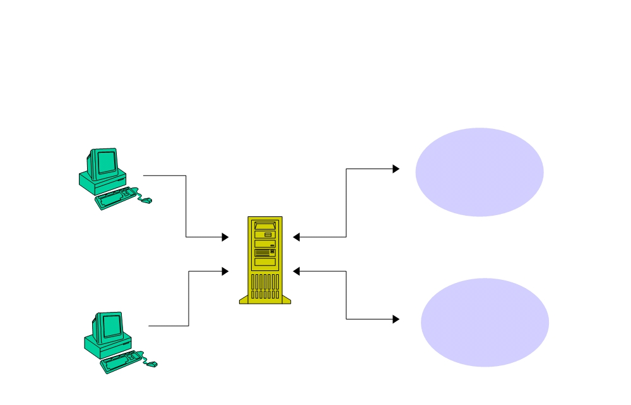
Antrix Consultancy Services
A Session Maintains Client Identity and State across multiple HTTP requests
Client 1
Session 1
server
Session ID 1
Client 2
Session ID 2
Session 2
Madhusudhanan.P.K.

Slide 116
Antrix Consultancy Services
Three “underlying” Session Tracking Mechanisms
§ Cookies
§ URL rewriting
§ Hidden form fields
§ Note that these are just underlying mechanisms of passing “session id”
do not provide high-level programming APIs
do not provide a framework for managing sessions
This is what Servlet Session Tracking feature provides
Madhusudhanan.P.K.

Slide 117
Antrix Consultancy Services
What is HTTP Cookie?
§ Cookie is a small amount of information sent by a servlet to a Web browser
§ Saved by the browser, and later sent back to the server in subsequent requests
A cookie has a name, a single value, and optional attributes
A cookie's value can uniquely identify a client
§ Server uses cookie's value to extract information about the session from some location on the server
Madhusudhanan.P.K.

Slide 118
Antrix Consultancy Services
Cookies as Session Tracking Mechanism
§ Advantages:
Very easy to implement Highly customizable
Persist across browser shut-downs
§ Disadvantages:
Often: users turn off cookies for privacy or security reason Not quite universal browser support
Madhusudhanan.P.K.

Slide 119
Antrix Consultancy Services
URL Rewriting
§ URLs can be rewritten or encoded to include session information.
§ URL rewriting usually includes a session id
§ Session id can be sent as an added parameter:
http://.../servlet/Rewritten?sessionid=688
Madhusudhanan.P.K.

Slide 120
Antrix Consultancy Services
URL Rewriting as Session Tracking Mechanism
§ Advantages:
Let user remain anonymous
They are universally supported(most styles)
§ Disadvantages:
Tedious to rewrite all URLs
Only works for dynamically created documents
Madhusudhanan.P.K.

Slide 121
Antrix Consultancy Services
Hidden Form Fields
§ Hidden form fields do not display in the browser, but can be sent back to the server by submit
<INPUT TYPE=”HIDDEN” NAME=”session” VALUE=”...”>
§ Fields can have identification (session id) or just some thing to remember (occupation)
§ Servlet reads the fields using req.getParameter()
Madhusudhanan.P.K.

Slide 122
Antrix Consultancy Services
Hidden Form Fields as Session Tracking Mechanism
§ Advantages:
Universally supported. Allow anonymous users
§ Disadvantages:
Only works for a sequence of dynamically generated forms.
Breaks down with static documents, emailed documents, bookmarked documents.
No browser shutdowns.
Madhusudhanan.P.K.

Slide 123
Antrix Consultancy Services
Why do we need Session Tracking feature of Servlet?
Madhusudhanan.P.K.

Slide 124
Antrix Consultancy Services
Now Without “Session Tracking” Feature of Servlet
§ Servlet programmers have to perform the following tasks themselves by using one of three session-tracking mechanisms
Generating and maintaining a session id for each session Passing session id to client via either cookie or URL Extracting session id information either from cookie or URL
Creating and maintaining a hashtable in which session id and session information are stored
Coming up with a scheme in which session information can be added or removed
Madhusudhanan.P.K.

Slide 125
Antrix Consultancy Services
“Session Tracking” Features of Servlet
§ Provides higher-level API for session tracking Built on top of Cookie or URL rewriting
§ Servlet container maintains
internal hashtable of session id's
session information in the form of HttpSession
§ Generates and maintains session id transparently
§ Provides a simple API for adding and removing session information (attributes) to HttpSession
§ Could automatically switch to URL rewriting if cookies are unsupported or explicitly disabled
Madhusudhanan.P.K.

Slide 126
Antrix Consultancy Services
Servlet Session Tracking Programming API
Madhusudhanan.P.K.

Slide 127
Antrix Consultancy Services
HttpSession
§ To get a user's existing or new session object:
HttpSession session = request.getSession(true);
• "true" means the server should create a new session object if necessary
HttpSession is Java interface
• Container creates a object of HttpSession type
Madhusudhanan.P.K.

Slide 128
Antrix Consultancy Services
Example: Getting HttpSession Object
public class CatalogServlet extends HttpServlet {
public void doGet (HttpServletRequest request, HttpServletResponse response)
throws ServletException, IOException {
// Get the user's session and shopping cart
HttpSession session =request.getSession(true);
out = response.getWriter();
}
}
Madhusudhanan.P.K.

Slide 129
Antrix Consultancy Services
HttpSession Java Interface
§ Contains Methods to
View and manipulate information about a session, such as the session identifier, creation time, and last accessed time
Bind objects to sessions, allowing user information to persist across multiple user connections
Madhusudhanan.P.K.

Slide 130
Antrix Consultancy Services
Store and Retrieve of Attribute
§ To stores values:
session.setAttribute("cartItem", cart);
§ To retrieves values:
session.getAttribute("cartItem");
Madhusudhanan.P.K.

Slide 131
Antrix Consultancy Services
Setting and Getting Attribute
public class CatalogServlet extends HttpServlet { public void doGet (HttpServletRequest request, HttpServletResponse response)
throws ServletException, IOException {
// Get the user's session and shopping cart
HttpSession session = request.getSession(true);
ShoppingCart cart = (ShoppingCart)session.getAttribute( "examples.bookstore.cart");
// If the user has no cart, create a new one if (cart == null) {
cart = new ShoppingCart();
session.setAttribute("examples.bookstore.cart", cart);
}
//see next slide.
}
}
Madhusudhanan.P.K.

Slide 132
Antrix Consultancy Services
How Servlet supports both Cookie- enabled and
Cookie-disable browsers?
Madhusudhanan.P.K.

Slide 133
Antrix Consultancy Services
If Cookie is turned off..
§ If your application makes use of session objects
you must ensure that session tracking is enabled by having the application rewrite URLs whenever the client turns off cookies
by calling the response's encodeURL(URL) method on all URLs returned by a servlet
This method includes the session ID in the URL only if cookies are disabled; otherwise, it returns the URL unchanged
Madhusudhanan.P.K.

Slide 134
Antrix Consultancy Services
String response.encodeURL(URL)
§ Encodes the specified URL by including the session ID in it, or, if encoding is not needed, returns the URL unchanged
Implementation of this method includes the logic to determine whether the session ID needs to be encoded in the URL
For example, if the browser supports cookies, or session tracking is turned off, URL encoding is unnecessary
§ For robust session tracking, all URLs emitted by a servlet should be run through this method
Otherwise, URL rewriting cannot be used with browsers which do not support cookies
Madhusudhanan.P.K.

Slide 135
Antrix Consultancy Services
Example: response.encodeURL()
out.println("<p> &nbsp; <p><strong><a href=\"" +
response.encodeURL(request.getContextPath() + "/catalog") + "\">" + messages.getString("ContinueShopping") + "</a> &nbsp; &nbsp; &nbsp;" +
"<a href=\"" +
response.encodeURL(request.getContextPath() + "/cashier") + "\">" + messages.getString("Checkout") +
"</a> &nbsp; &nbsp; &nbsp;" +
"<a href=\"" +
response.encodeURL(request.getContextPath() + "/showcart?Clear=clear") +
"\">" + messages.getString("ClearCart") + "</a></strong>");
Madhusudhanan.P.K.

Slide 136
Antrix Consultancy Services
Example: URL
§ If cookies are turned off
http://localhost:8080/bookstore1/cashier;jsessionid=c0o7fszeb1
§ If cookies are turned on
http://localhost:8080/bookstore1/cashier
Madhusudhanan.P.K.

Slide 137
Antrix Consultancy Services
Session Timeout & Invalidation
Madhusudhanan.P.K.

Slide 138
Antrix Consultancy Services
Session Timeout
§ Used when an end-user can leave the browser without actively closing a session
§ Sessions usually timeout after 30 minutes of inactivity
Product specific
A different timeout may be set by server admin
§ getMaxInactiveInterval(), setMaxInactiveInterval() methods of HttpSession interface
Gets or sets the amount of time, session should go without access before being invalidated
Madhusudhanan.P.K.

Slide 139
Antrix Consultancy Services
Issues with “Stale” Session Objects
§ The number of “stale” session objects that are in “to be timed out” could be rather large
§ Example
1000 users with average 2 minutes session time, thus 15000 users during the 30 minutes period
4K bytes of data per session
15000 sessions * 4K -= 60M bytes of session data This is just for one Web application
§ Could have an performance impact
Use the data space in Session object with care
Madhusudhanan.P.K.

Slide 140
Antrix Consultancy Services
Session Invalidation
§ Can be used by servlet programmer to end a session proactively
when a user at the browser clicks on “log out” botton
when a business logic ends a session (“checkout” page in the example code in the following slide)
§ public void invalidate()
Expire the session and unbinds all objects with it
§ Caution
Remember that a session object is shared by multiple servlets/JSP-pages and invalidating it could destroy data that other servlet/JSP-pages are using
Madhusudhanan.P.K.

Slide 141
Antrix Consultancy Services
Example: Invalidate a Session
public class ReceiptServlet extends HttpServlet { public void doPost(HttpServletRequest request,
HttpServletResponse response)
throws ServletException, IOException {
scart = (ShoppingCart)
session.getAttribute("examples.bookstore.cart");
// Clear out shopping cart by invalidating the session session.invalidate();
// set content type header before accessing the Writer response.setContentType("text/html");
out = response.getWriter();
}
}
Madhusudhanan.P.K.

Slide 142
Antrix Consultancy Services
“Session Object Unboud” Event Notification
§ Any attribute object that implements HttpSessionBindingListener interface gets an notification
valueUnbound(HttpSessionBindingEvent event)
§ Note: when your servlet adds an attribute to HttpSession via setAttribute() method, the container calls
valueBound(HttpSessionBindingEvent event)
Madhusudhanan.P.K.

Slide 143
Antrix Consultancy Services
Servlet Filters
Madhusudhanan.P.K.

Slide 144
Antrix Consultancy Services
Sub-Agenda: Servlet Filters
§ What is & Why servlet filters (with use case scenarios)?
§ How are servlet filters chained?
§ Servlet filter programming APIs
§ Servlet filter configuration in web.xml
§ Steps for building and deploying servlet filters
§ Example code
Madhusudhanan.P.K.

Slide 145
Antrix Consultancy Services
What is and Why Servlet Filter?
Madhusudhanan.P.K.

Slide 146
Antrix Consultancy Services
What are Java Servlet Filters?
§ New component framework for intercepting and modifying requests and responses
Filters can be chained and plugged in to the system during deployment time
§ Allows range of custom activities:
Marking access, blocking access
Caching, compression, logging
Authentication, access control, encryption Content transformations
§ Introduced in Servlet 2.3 (Tomcat 4.0)
Madhusudhanan.P.K.

Slide 147
Antrix Consultancy Services
What Can a Filter Do?
§ Examine the request headers
§ Customize the request object if it wishes to modify request headers or data
§ Customize the response object if it wishes to modify response headers or data
§ Invoke the next entity in the filter chain
§ Examine response headers after it has invoked the next filter in the chain
§ Throw an exception to indicate an error in processing
Madhusudhanan.P.K.

Slide 148
Antrix Consultancy Services
Use Case Scenario 1 of Filters[4]
§ You have many servlets and JSP pages that need to perform common functions such as logging or XSLT transformation
You want to avoid changing all these servlets and JSP pages
You want to build these common functions in a modular and reusable fashion
§ Solution
build a single logging filter and compression filter plug them at the time of deployment
Madhusudhanan.P.K.

Slide 149
Antrix Consultancy Services
Use Case Scenario 2 of Filters[4]
§ How do you separate access control decisions from presentation code (JSP pages)
You do not want to change individual JSP pages since it will mix “access-control” logic with presentation logic
§ Solution
build and deploy a “access-control” servlet
Madhusudhanan.P.K.

Slide 150
Antrix Consultancy Services
Use Case Scenario 3 of Filters[4]
§ You have many existing Web resources that need to remain unchanged except a few values (such as banners or company name)
You cannot make changes to these Web resources every time company name gets changed
§ Solution
Build and deploy “banner replacement filter” or “company name replacement filter”
Madhusudhanan.P.K.

Slide 151
Antrix Consultancy Services
How are
Servlet Filters chained?
Madhusudhanan.P.K.

Slide 152
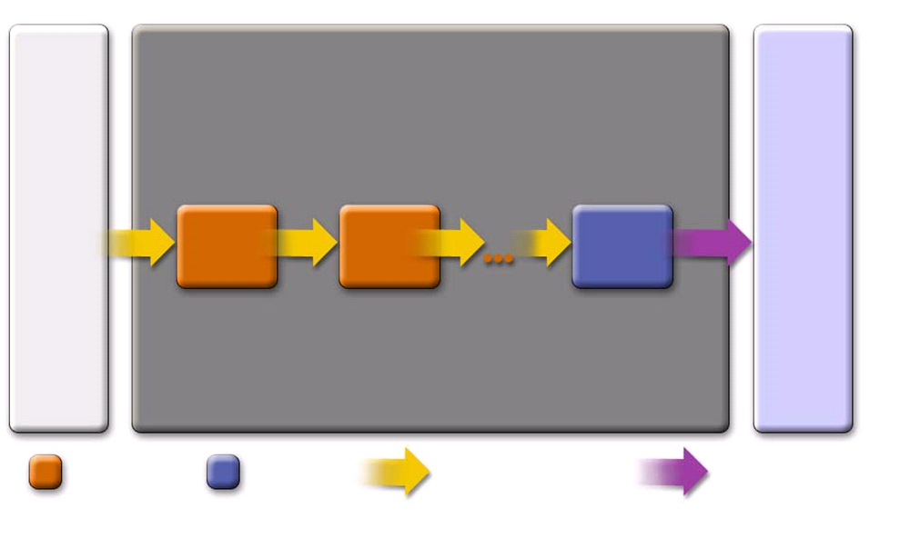
Antrix Consultancy Services
How Servlet Filter Work?
Servlet
Filter Chain
Servlet
Container
Filter 1
Filter 2
Filter N
doFilter(
service(
User Servlet
ServletRequest, ServletResponse, FilterChain)
ServletRequest, ServletResponse)
implemented container filters filter
Madhusudhanan.P.K.

Slide 153
Antrix Consultancy Services
How Filter Chain Works
§ Multiple filters can be chained
order is dictated by the order of <filter> elements in the web.xml deployment descriptor
§ The first filter of the filter chain is invoked by the container
via doFilter(ServletRequest req, ServletResponse res, FilterChain chain)
the filter then perform whatever filter logic and then call the next filter in the chain by calling chain.doFilter(..) method
§ The last filter's call to chain.doFilter() ends up calling service() method of the Servlet
Madhusudhanan.P.K.

Slide 154
Antrix Consultancy Services
Servlet Filter
Programming APIs
Madhusudhanan.P.K.

Slide 155
Antrix Consultancy Services
javax.servlet.Filter Interface
§ init(FilterConfig)
called only once when the filter is first initialized
get ServletContext object from FilterConfig object and save it somewhere so that doFilter() method can access it
read filter initialization parameters from FilterConfig object through getInitParameter() method
§ destroy()
called only once when container removes filter object close files or database connections
Madhusudhanan.P.K.

Slide 156
Antrix Consultancy Services
javax.servlet.Filter Interface
§ doFilter(ServletRequest req, ServletResponse res, FilterChain chain) gets called each time a filter is invoked
contains most of filtering logic
ServletRequest object is casted to HttpServletRequest if the request is HTTP request type may wrap request/response objects
invoke next filter by calling chain.doFilter(..) or block request processing
• by omitting calling chain.doFilter(..)
• filter has to provide output the client
set headers on the response for next entity
Madhusudhanan.P.K.

Slide 157
Antrix Consultancy Services
Other Sevlet Filter Related Classes
§ javax.servlet.FilterChain
passed as a parameter in doFilter() method
§ javax.servlet.FilterConfig
passed as a parameter in init() method
§ javax.servlet.HttpServletResponseWrapper
convenient implementation of the HttpServletResponse interface
Madhusudhanan.P.K.

Slide 158
Antrix Consultancy Services
Servlet Filter
Configuration in web.xml file
Madhusudhanan.P.K.

Slide 159
Antrix Consultancy Services
Configuration in web.xml
§
<filter>
<filter-name>: assigns a name of your choosing to the filter
<filter-class>: used by the container to identify the filter class
§
</filter>
§
<filter-mapping>
<filter-name>: assigns a name of your choosing to the filter
<url-pattern>: declares a pattern URLs (Web resources) to which the filter applies
§ </filter-mapping>
Madhusudhanan.P.K.

Slide 160
Antrix Consultancy Services
Example: web.xml of BookStore
<web-app>
<display-name>Bookstore1</display-name> <description>no description</description>
<filter>
<filter-name>OrderFilter</filter-name>
<filter-class>filters.OrderFilter</filter-class> </filter>
<filter>
<filter-name>HitCounterFilter</filter-name>
<filter-class>filters.HitCounterFilter</filter-class> </filter>
<filter-mapping>
<filter-name>OrderFilter</filter-name> <url-pattern>/receipt</url-pattern> </filter-mapping>
<filter-mapping>
<filter-name>HitCounterFilter</filter-name> <url-pattern>/enter</url-pattern>
</filter-mapping> <listener> ... </listener> <servlet> ... </servlet>
Madhusudhanan.P.K.

Slide 161
Antrix Consultancy Services
Steps for Building and
Deploying Servlet Filters
Madhusudhanan.P.K.

Slide 162
Antrix Consultancy Services
Steps for Building a Servlet Filter
§ Decide what custom filtering behavior you want to implement for a web resource
§ Create a class that implements Filter interface
Implement filtering logic in the doFilter() method Call the doFilter() method of FilterChain object
§ Configure the filter with Target servlets and JSP pages
use <filter> and <filter-mapping> elements
Madhusudhanan.P.K.

Slide 163
Antrix Consultancy Services
Servlet Filter Example Code
Madhusudhanan.P.K.

Slide 164
Antrix Consultancy Services
Example: HitCounterFilter
public final class HitCounterFilter implements Filter { private FilterConfig filterConfig = null;
public void init(FilterConfig filterConfig)
throws ServletException {
this.filterConfig = filterConfig;
}
public void destroy() {
this.filterConfig = null; }
// Continued in the next page...
Madhusudhanan.P.K.

Slide 165
Antrix Consultancy Services
Example: HitCounterFilter
public void doFilter(ServletRequest request,
ServletResponse response, FilterChain chain)
throws IOException, ServletException {
if (filterConfig == null) return;
StringWriter sw = new StringWriter();
PrintWriter writer = new PrintWriter(sw); Counter counter =
(Counter)
filterConfig.getServletContext().getAttribute("hitCounter"); writer.println("The number of hits is: " +
counter.incCounter());
// Log the resulting string writer.flush();
filterConfig.getServletContext().log(sw.getBuffer().toString());
chain.doFilter(request, wrapper);
}
}
Madhusudhanan.P.K.

Slide 166
Antrix Consultancy Services
HitCounterFilter Configuration
<?xml version="1.0" encoding="ISO-8859-1"?>
<!DOCTYPE web-app PUBLIC '-//Sun Microsystems, Inc.//DTD Web Application 2.3//EN' 'http://java.sun.com/dtd/web- app_2_3.dtd'>
<web-app>
<display-name>Bookstore1</display-name>
<description>no description</description>
<filter>
<filter-name>HitCounterFilter</filter-name>
<filter-class>filters.HitCounterFilter</filter-class> </filter>
<filter-mapping>
<filter-name>HitCounterFilter</filter-name> <url-pattern>/enter</url-pattern>
</filter-mapping>
Madhusudhanan.P.K.

Slide 167
Antrix Consultancy Services
Servlet
LifeCycle Events
Madhusudhanan.P.K.

Slide 168
Antrix Consultancy Services
Servlet Lifecycle Events
§ Support event notifications for state changes in
ServletContext
• Startup/shutdown
• Attribute changes
HttpSession
• Creation and invalidation
• Changes in attributes
Madhusudhanan.P.K.

Slide 169
Antrix Consultancy Services
Steps for Implementing Servlet Lifecycle Event
1. Decide which scope object you want to receive an event notification
2. Implement appropriate interface
3. Override methods that need to respond to the events of interest
4. Obtain access to important Web application objects and use them
5. Configure web.xml accordingly
6. Provide any needed initialization parameters
Madhusudhanan.P.K.

Slide 170
Antrix Consultancy Services
Listener Registration
§ Web container
creates an instance of each listener class
registers it for event notifications before processing first request by the application
Registers the listener instances according to
• the interfaces they implement
• the order in which they appear in the deployment descriptor web.xml
§ Listeners are invoked in the order of their registration during execution
Madhusudhanan.P.K.

Slide 171
Antrix Consultancy Services
Listener Interfaces
§ ServletContextListener
contextInitialized/Destroyed(ServletContextEvent)
§ ServletContextAttributeListener
attributeAdded/Removed/Replaced(
ServletContextAttributeEvent)
§ HttpSessionListener
sessionCreated/Destroyed(HttpSessionEvent)
§ HttpSessionAttributeListener
attributedAdded/Removed/Replaced(
HttpSessionBindingEvent)
§ HttpSessionActivationListener
Handles sessions migrate from one server to another sessionWillPassivate(HttpSessionEvent) sessionDidActivate(HttpSessionEvent)
Madhusudhanan.P.K.

Slide 172
Antrix Consultancy Services
Example: Context Listener
public final class ContextListener
implements ServletContextListener {
private ServletContext context = null;
public void contextInitialized(ServletContextEvent event) {
context = event.getServletContext();
try {
BookDB bookDB = new BookDB();
context.setAttribute("bookDB", bookDB); } catch (Exception ex) {
context.log("Couldn't create bookstore database bean: " +
ex.getMessage()); }
Counter counter = new Counter();
context.setAttribute("hitCounter", counter); counter = new Counter();
context.setAttribute("orderCounter", counter);
}
Madhusudhanan.P.K.

Slide 173
Antrix Consultancy Services
Example: Context Listener
public void contextDestroyed(ServletContextEvent event)
{
context = event.getServletContext(); BookDB bookDB =
(BookDB)context.getAttribute("bookDB"); bookDB.remove();
context.removeAttribute("bookDB");
context.removeAttribute("hitCounter");
context.removeAttribute("orderCounter"); }
}
Madhusudhanan.P.K.

Slide 174
Antrix Consultancy Services
Listener Configuration
<web-app>
<display-name>Bookstore1</display-name>
<description>no description</description>
<filter>..</filter>
<filter-mapping>..</filter-mapping>
<listener>
<listener-class>listeners.ContextListener</listener-class> </listener>
<servlet>..</servlet>
<servlet-mapping>..</servlet-mapping> <session-config>..</session-config> <error-page>..</error-page>
</web-app>
Madhusudhanan.P.K.

Slide 175
Antrix Consultancy Services
Including, Forwarding, Redirecting to other Web resources
Madhusudhanan.P.K.

Slide 176
Antrix Consultancy Services
Including another Web Resource
Madhusudhanan.P.K.

Slide 177
Antrix Consultancy Services
When to Include another Web resource?
§ When it is useful to add static or dynamic contents already created by another web resource
Adding a banner content or copyright information in the response returned from a Web component
Madhusudhanan.P.K.

Slide 178
Antrix Consultancy Services
Types of Included Web Resource
§ Static resource
It is like “programmatic” way of adding the static contents in the response of the “including” servlet
§ Dynamic web component (Servlet or JSP page)
Send the request to the “included” Web component Execute the “included” Web component
Include the result of the execution the “included” Web component in the response of the “including” servlet
Madhusudhanan.P.K.

Slide 179
Antrix Consultancy Services
Things that Included Web Resource can and cannot do
§ Included Web resource has access to the request object, but it is limited in what it can do with the response
It can write to the body of the response and commit a response
It cannot set headers or call any method (for example, setCookie) that affects the headers of the response
Madhusudhanan.P.K.

Slide 180
Antrix Consultancy Services
How to Include another Web resource?
§ Get RequestDispatcher object from ServletConext object
RequestDispatcher dispatcher =
getServletContext().getRequestDispatcher("/banner");
§ Invoke the include() method of the RequestDispatcher object
dispatcher.include(request, response);
Madhusudhanan.P.K.

Slide 181
Antrix Consultancy Services
Example: BannerServlet as “Included” Web component
public class BannerServlet extends HttpServlet {
public void doGet (HttpServletRequest request, HttpServletResponse response)
throws ServletException, IOException {
PrintWriter out = response.getWriter();
out.println("<body bgcolor=\"#ffffff\">" +
"<center>" + "<hr> <br> &nbsp;" + "<h1>" +
"<font size=\"+3\" color=\"#CC0066\">Duke's </font>" + <img src=\"" + request.getContextPath() + "/duke.books.gif\">" +
"<font size=\"+3\" color=\"black\">Bookstore</font>" + "</h1>" + "</center>" + "<br> &nbsp; <hr> <br> "); }
public void doPost (HttpServletRequest request, HttpServletResponse response)
throws ServletException, IOException {
PrintWriter out = response.getWriter();
out.println("<body bgcolor=\"#ffffff\">" +
"<center>" + "<hr> <br> &nbsp;" + "<h1>" +
"<font size=\"+3\" color=\"#CC0066\">Duke's </font>" + <img src=\"" + request.getContextPath() + "/duke.books.gif\">" +
"<font size=\"+3\" color=\"black\">Bookstore</font>" + "</h1>" + "</center>" + "<br> &nbsp; <hr> <br> ");
}}
Madhusudhanan.P.K.

Slide 182
Antrix Consultancy Services
Example: Including “BannerServlet”
RequestDispatcher dispatcher =
getServletContext().getRequestDispatcher("/banner"); if (dispatcher != null)
dispatcher.include(request, response);
}
Madhusudhanan.P.K.

Slide 183
Antrix Consultancy Services
Forwarding to another Web Resource
Madhusudhanan.P.K.

Slide 184
Antrix Consultancy Services
When to use “Forwarding” to another Web resource?
§ When you want to have one Web component do preliminary processing of a request and have another component generate the response
§ You might want to partially process a request and then transfer to another component depending on the nature of the request
Madhusudhanan.P.K.

Slide 185
Antrix Consultancy Services
Rules of “Forwarding” to another Web resource?
§ Should be used to give another resource responsibility for replying to the user
If you have already accessed a ServletOutputStream or PrintWriter object within the servlet, you cannot use this method; it throws an IllegalStateException
Madhusudhanan.P.K.

Slide 186
Antrix Consultancy Services
How to do “Forwarding” to another Web resource?
§ Get RequestDispatcher object from HttpServletRequest object Set “request URL” to the path of the forwarded page
RequestDispatcher dispatcher
= request.getRequestDispatcher("/template.jsp");
§ If the original URL is required for any processing, you can save it as a request attribute
§ Invoke the forward() method of the RequestDispatcher object
dispatcher.forward(request, response);
Madhusudhanan.P.K.

Slide 187
Antrix Consultancy Services
Example: Dispatcher Servlet
public class Dispatcher extends HttpServlet {
public void doGet(HttpServletRequest request, HttpServletResponse response) {
request.setAttribute("selectedScreen", request.getServletPath());
RequestDispatcher dispatcher = request. getRequestDispatcher("/template.jsp");
if (dispatcher != null)
dispatcher.forward(request, response);
}
public void doPost(HttpServletRequest request,
}
Madhusudhanan.P.K.

Slide 188
Antrix Consultancy Services
Instructing Browser to Redirecting to another Web Resource
Madhusudhanan.P.K.

Slide 189
Antrix Consultancy Services
Redirecting a Request
§ Two programming models for directing a request
§ Method 1:
res.setStatus(res.SC_MOVED_PERMANTLY);
res.setHeader("Location", "http://...");
§ Method 2:
public void sendRedirect(String url)
Madhusudhanan.P.K.

Slide 190
Antrix Consultancy Services
Servlet
Synchronization & Thread Model
Madhusudhanan.P.K.

Slide 191
Antrix Consultancy Services
Concurrency Issues on a Servlet
§ The service() method of a servlet instance can be invoked by multiple clients (multiple threads)
§ Servlet programmer has to deal with concurrency issue
shared data needs to be protected
this is called “servlet synchronization”
§ 2 options for servlet synchronization
use of synchronized block
use of SingleThreadModel
Madhusudhanan.P.K.

Slide 192
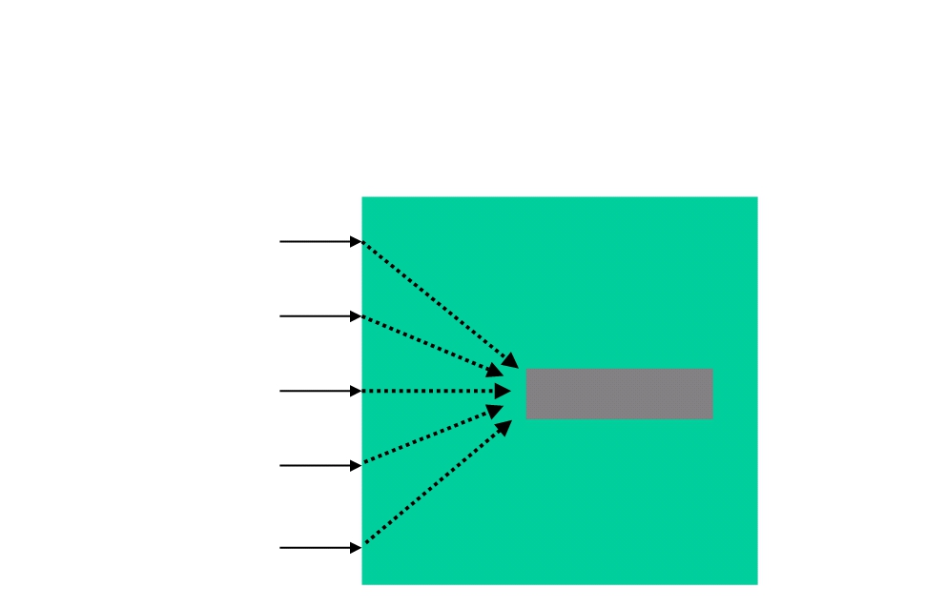
Antrix Consultancy Services
Many Threads,
One Servlet Instance
Web Server
request
request request request
thread
thread
thread
Servlet
thread
thread
request
Servlet container
Madhusudhanan.P.K.

Slide 193
Antrix Consultancy Services
Use of synchronized block
§ Synchronized blocks are used to guarantee only one thread at a time can execute within a section of code
synchronized(this) {
myNumber = counter + 1; counter = myNumber; }
synchronized(this) {
counter = counter - 1 ; }
Madhusudhanan.P.K.

Slide 194
Antrix Consultancy Services
SingleThreadModel Interface
§ Servlets can also implement javax.servlet.SingleThreadModel
§ The server will manage a pool of servlet instances
§ Guaranteed there will only be one thread per instance
§ This could be overkill in many instances
Public class SingleThreadModelServlet extends HttpServlet implements SingleThreadModel {
}
Madhusudhanan.P.K.

Slide 195
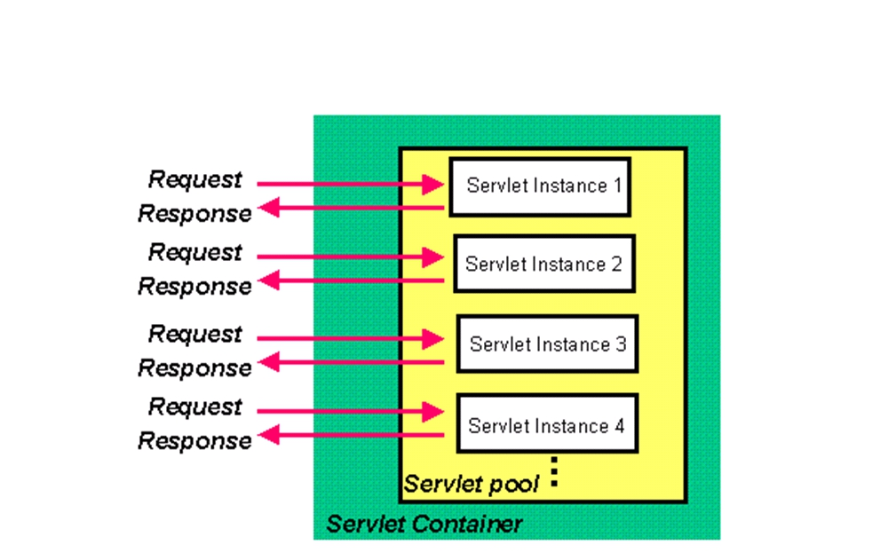
Antrix Consultancy Services
SingleThreadModel
Web Server
thread
thread
thread
thread
Madhusudhanan.P.K.

Slide 196
Antrix Consultancy Services
Best Practice Recommendation
§ Do use synchronized block whenever possible
SingleThreadModel is expensive (performance wise)
Madhusudhanan.P.K.

